Slide 1
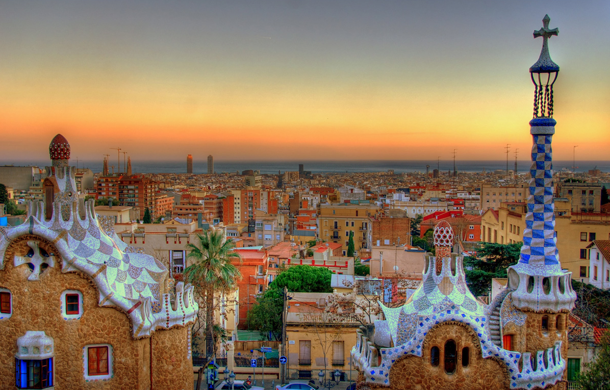
Cataluña

Slide 2
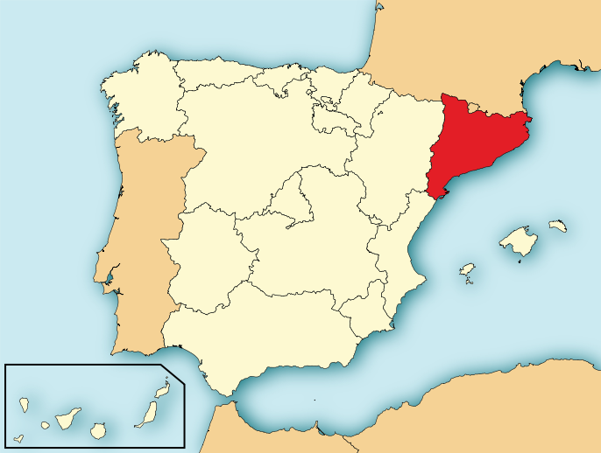
Facts
Territory: Catalonia
Status: Autonomous community within Spain
Population: 7.5 million
Capital: Barcelona
Major languages: Catalan, Spanish (Castilian)
Catalunia is also located on the
North East side of Spain, near Valencia and Aragon.

Slide 3
Culture
The correfocs is a festival, in which "devils" play with fire close to the onlookers, which is one of the most striking of the Catalan festive events. The devils are not considered the incarnation of evil; they are sprightly and festive characters, dancing to the sound of drums and the traditional gralla, while they set off their fireworks.
Another tradition occurs during the spring festival day of Sant Jordi (St George's Day, 23 April), in which men give roses (mostly in a deep red color) to women, and women give a book to men as a present. That day is also known as "Dia del Llibre" (Book Day), coinciding with the anniversaries of the deaths of William Shakespeare, Miguel de Cervantes and Josep Pla. The streets are full of people gathering around book and flower stands.
Perhaps the most spectacular of the Catalan festivals are those of the colles castelleres, groups of enthusiasts who form impressive human towers (up to ten people high). This is an old tradition of the Tarragona region, which has now spread to many parts of Catalonia, and has become a real spectacle, or sport, that attracts thousands of people.

Slide 4
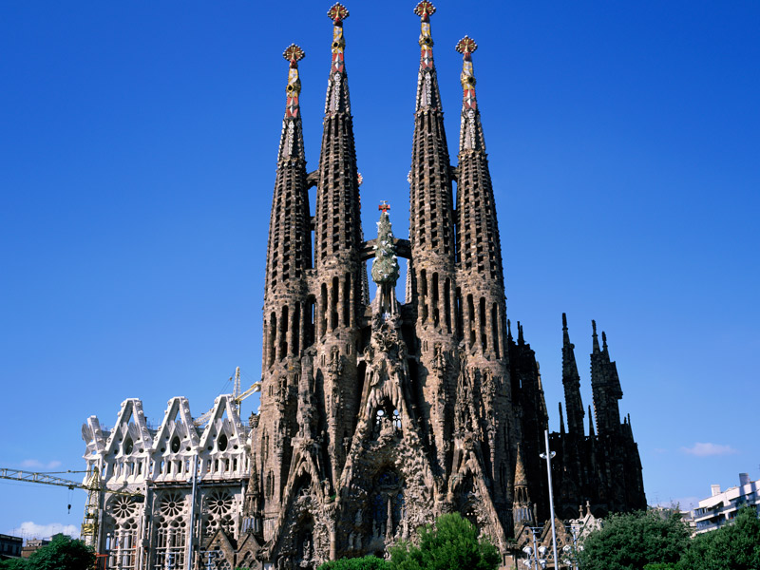
Tourism
The spectacular beaches in areas such as the Costa Brava, its world-class gastronomy, and the works of famous artists such as Gaudí and Dalí all make Cataluna one of Spain’s most popular destinations.
You’ll find so many interesting examples of culture that you won't even know where to begin: unique buildings in Barcelona (known as “the capital of Modernism”) such as the Sagrada Familia Cathedral or the Palau de la Música Catalana Auditorium, the outstanding archaeological site at Tarraco, the monastery of Poblet in Tarragona and the churches of the Boí valley in Lleida.

Slide 5
History
Trade has been active along the coast of Cataluna since Greek and Roman times. The history of medieval Cataluna is that of the counts of Barcelona, who emerged in the 9th century as the chief lords in the Spanish March founded by Charlemagne.
Catalan art and literature flourished in the Middle Ages, and in the cities, mostly Barcelona, the burgher and merchants became very powerful.
Cataluna failed in it's rebellion against John II of Aragon, and after the union in 1479, of Aragon and Castille, Cataluna declined. Trade routes shifted with the consequent loss of commercial income, there were pirate attacks, and recurring plagues and famines.
Under the Franco dictatorship, the use of Catalan anywhere in Spain was banned in public. Cataluna elected its first parliament as an autonomous region in 1980.
In 2006, the recognition of Cataluna as a “nation” within Spain was approved, however the Spanish government blocked a proposed Catalonian independence referendum in 2012. Catalunian parties have continued nonetheless to press the issue.

